Slide 1
Search
Tuomas Sandholm
Read Russell & Norvig Sections 3.1-3.4.
(Also read Chapters 1 and 2 if you haven’t already.)
Minor additions by Dave Touretzky in 2018

Slide 2
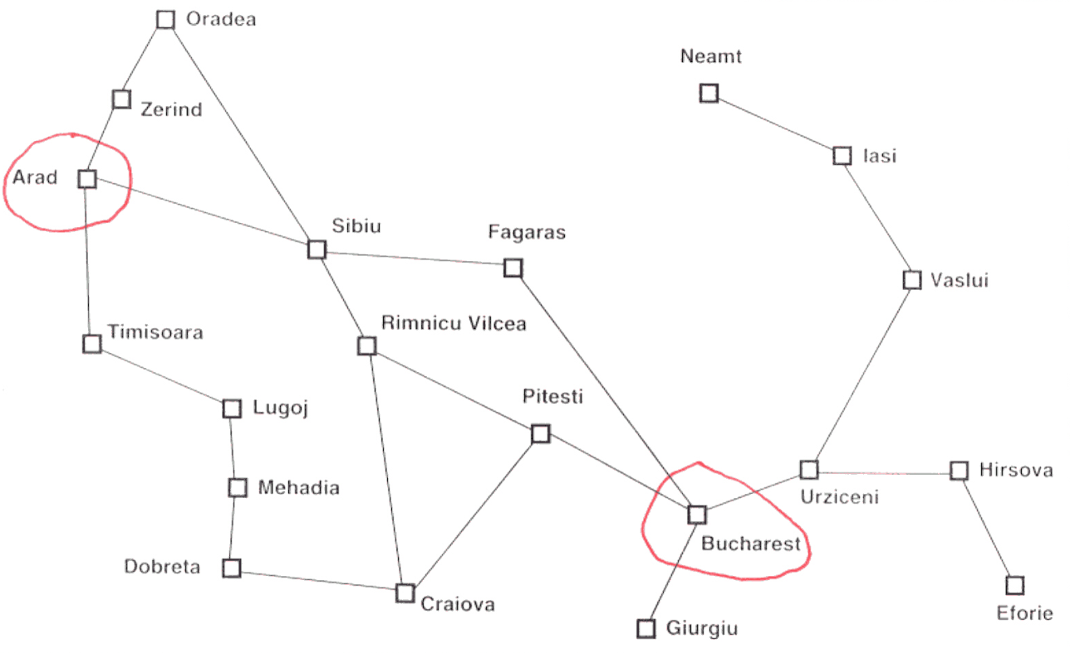
Search
Goal-based agent
In some applications we are interested in finding a goal node, in other applications we are interested in finding a path to a goal
No map vs. Map
physical deliberative
search search

Slide 3
Search setting
“Formulate, Search, Execute” (sometimes interleave search & execution)
For now we assume:
Full observability, i.e., known state
Known effects of actions
Data type problem
Initial state (perhaps an abstract characterization)
vs. partial observability (set of states)
  Operators
  Goal-test (maybe many goals)
  Path-cost-function
Problem formulation can make huge difference in computational efficiency. Things to consider:
Actions and states at the right level of detail, i.e., right level of abstraction
E.g., in navigating from Arad to Bucharest, not “move leg 2 degrees right”
Generally want to avoid symmetries (e.g., in CSPs & MIP discussed later)

Slide 4
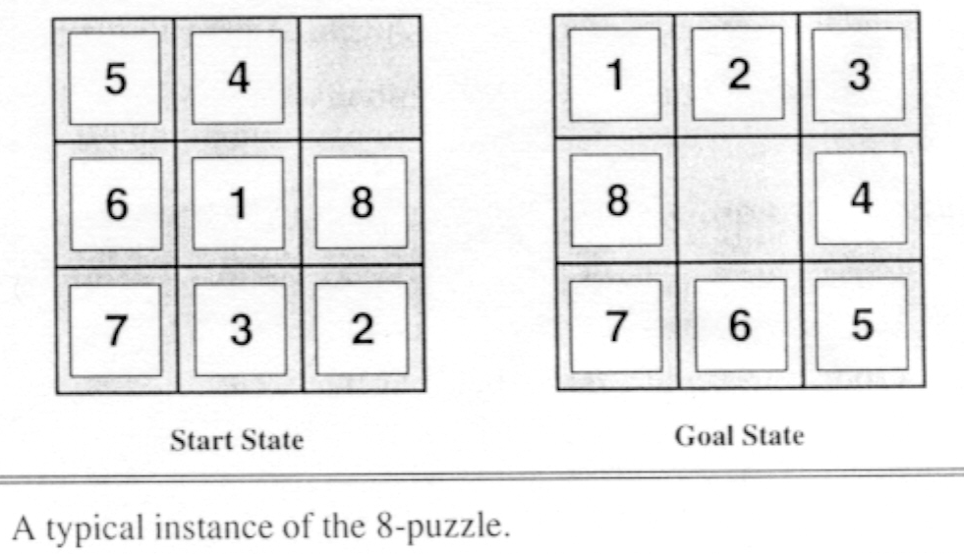
Example search problem:
8-puzzle
How to model operators? (moving tiles vs. blank)
Path cost = 1
(Aside: for n-puzzle, finding a solution is easy, but finding shortest solution is NP-hard)

Slide 5
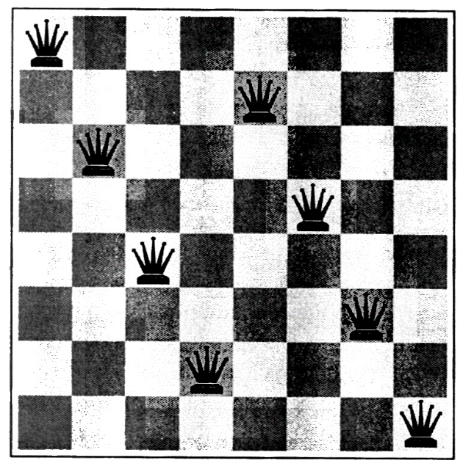
Example search problem:
8-queens (or n-queens)
path cost = 0: in this application we’re interested in a node, not a path
Incremental formulation:
(constructive search)
States: any arrangement of 0 to 8 queens on board
Ops: add a queen to any square
# sequences = 64⁸
Complete State formulation: (iterative improvement)
States: arrangement of 8 queens, 1 in each column
Ops: move any attacked queen to another square in the same column
Improved incremental formulation:
States: any arrangement of 0 to 8 queens on board with none attacked
Ops: place a queen in the left-most empty column such that it is not attacked by any other queen
# sequences = 2057
Almost a solution to the 8-queen problem:
(Incidentally, even the general class with n queens has an efficient solution, so search would not be the method of choice.)

Slide 6
Other examples of search problems
Rubik’s cube ~ 10¹⁹ states
Cryptarithmetic
FORTY 29786
+ TEN + 850
+ TEN + 850
SIXTY 31486
Real world problems
  1. Routing (robots, vehicles, salesman)
  2. Scheduling & sequencing
  3. Layout (VLSI, Advertisement, Mobile phone link stations)
  4. Winner determination in combinatorial auctions
  5. Which combination of cycles to accept in kidney exchange?
  …

Slide 7

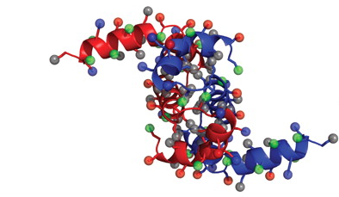
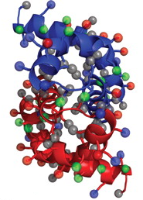
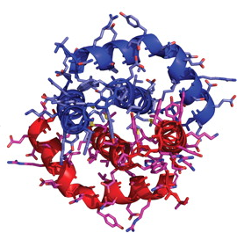
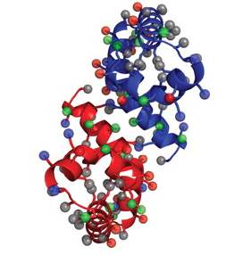
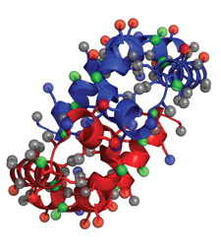
Example: Protein folding

Slide 8
Data type node
State
Parent-node
Operator
Depth
Path-cost
Fringe = frontier = open list (as queue)

Slide 9
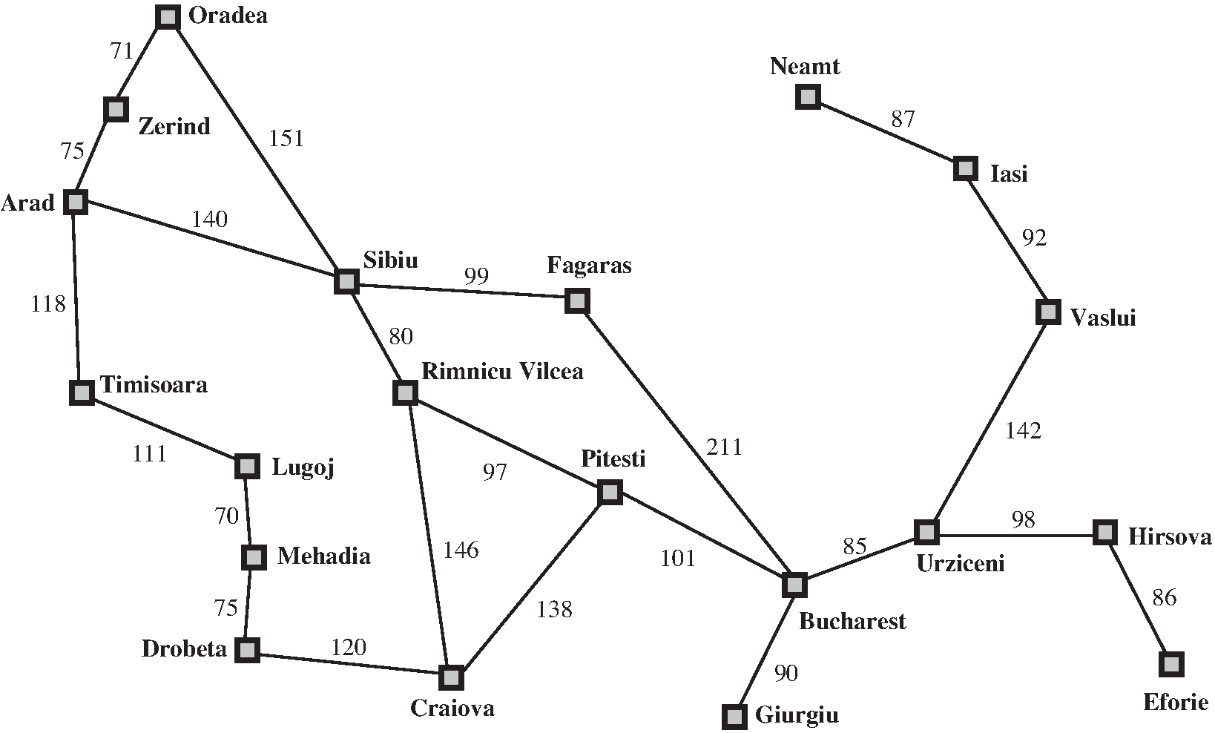
Best Path from Arad to Bucharest

Slide 10
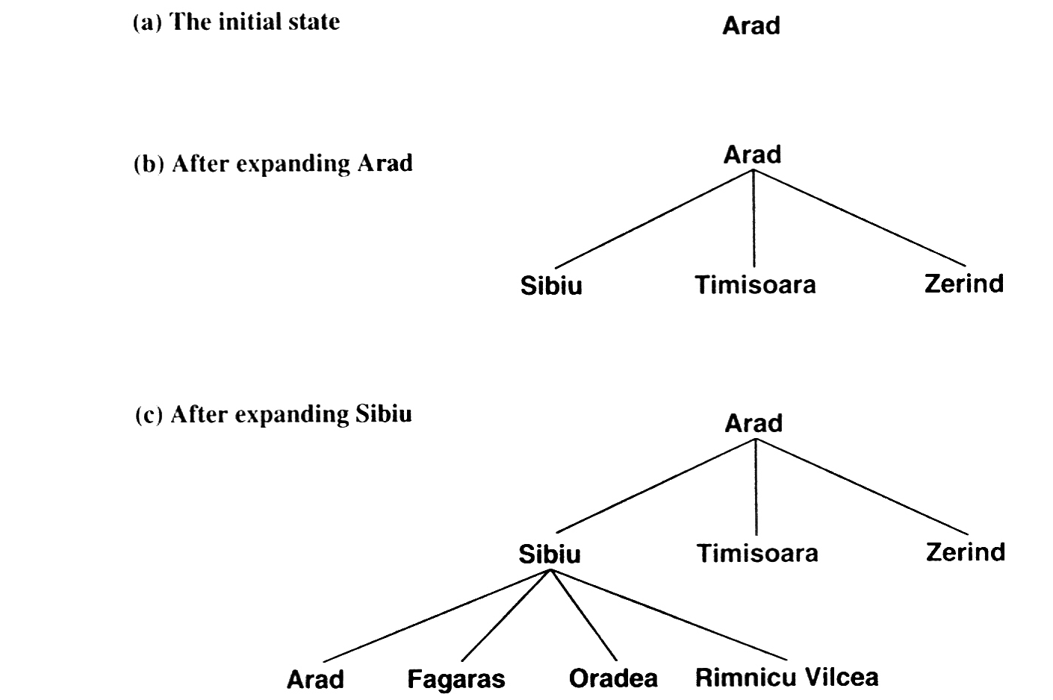
Partial search tree for route finding from Arad to Bucharest

Slide 11
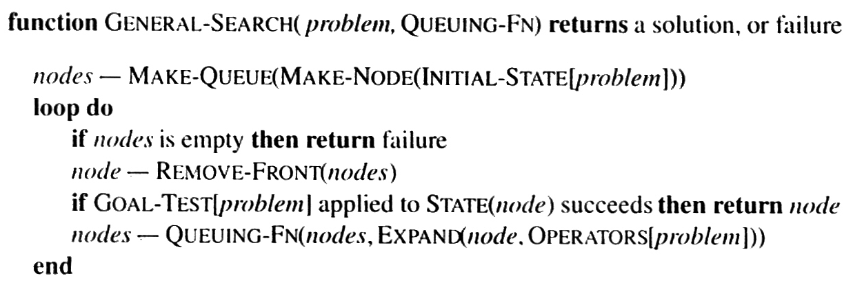
The general search algorithm
(Note that QUEUEING-FN is a variable whose value will be a function)

Slide 12



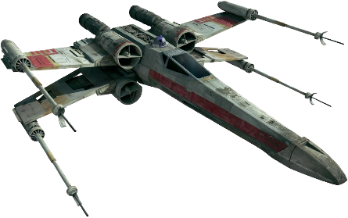
Measures of performance
Completeness
Optimality
Time
Space
Guaranteed to find a solution when there is one?
Finds an optimal solution?
How long does it take to find a solution?
How much memory is needed to conduct the search?
An aside: A bounded rationality perspective
Search cost is about time cost and space cost.
Domain cost = path cost
Total cost = domain cost + search cost

Slide 13

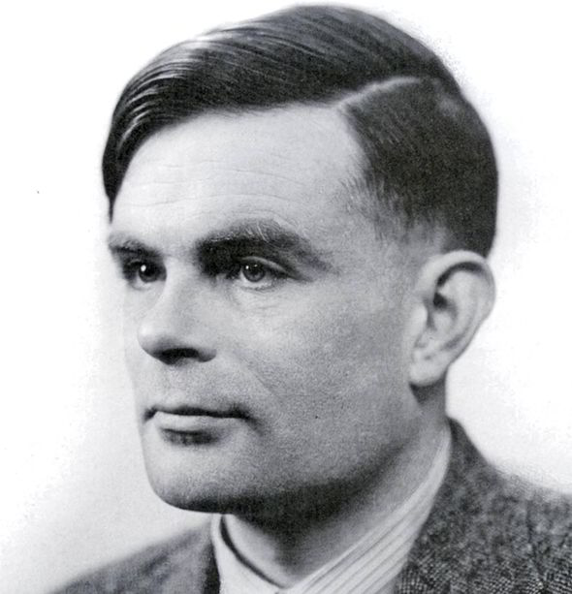
Uninformed vs. informed search
Uninformed
Informed
Can only generate successors and distinguish goals from non-goals
Strategies that know whether one non-goal is more promising than another

Slide 14
Breadth-First Search
function BREADTH-FIRST-SEARCH (problem) returns a solution or failure
return GENERAL-SEARCH (problem, ENQUEUE-AT-END)
Breadth-first search tree after 0,1,2 and 3 node expansions
Head node of open list is circled in green

Slide 15
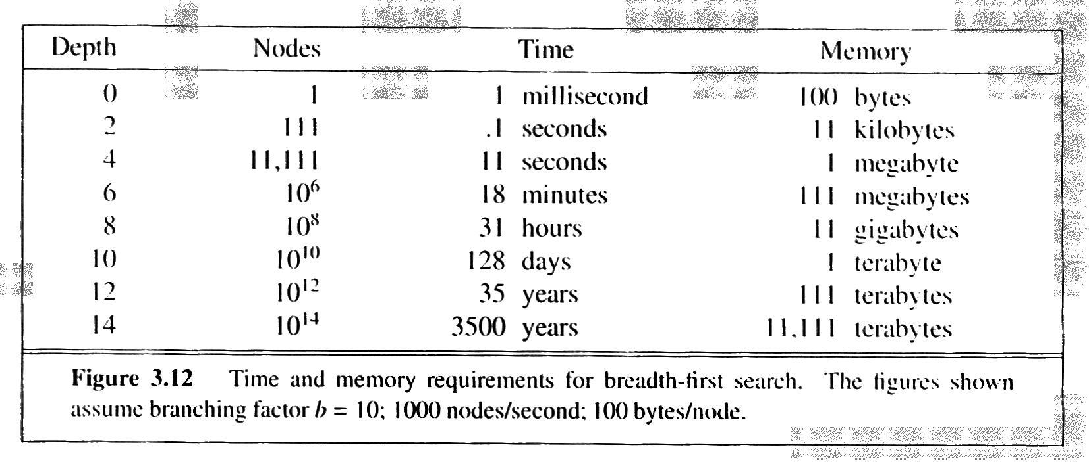
Breadth-First Search …
Max 1 + b + b² + … + b^{d} nodes (d is the depth of the shallowest goal)
Complete
Exponential time & memory Θ(b^{d})
Finds optimum if path-cost is a non-decreasing function of the depth of the node

Slide 16
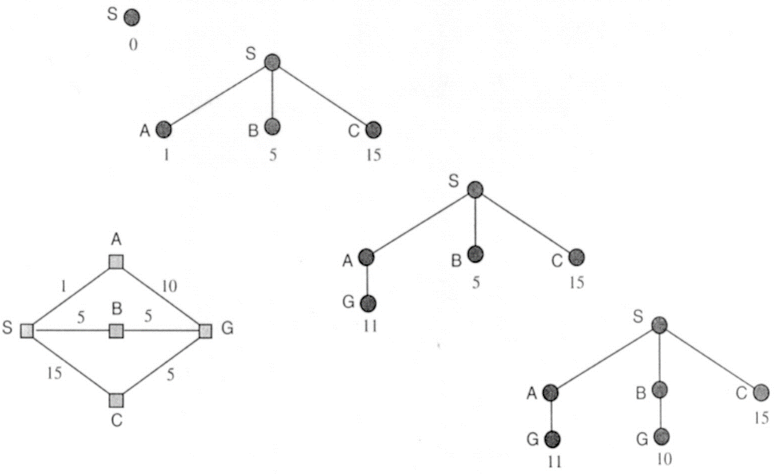
Uniform-Cost Search
Insert nodes onto open list in ascending order of g(n).
Progression of the search
Each node is labeled with g(n)
State space
G inserted into open list although it is a goal state. Otherwise cheapest path to a goal may not be found.
At the next step,
the goal node with g=10 will be selected.
Finds optimum if the cost of a path never decreases as we go along the path. g(SUCCESSORS(n)) ≥ g(n) ⬄ (Operator costs ≥ 0)
If this does not hold, nothing but an exhaustive search is guaranteed to find an optimal solution.

Slide 17
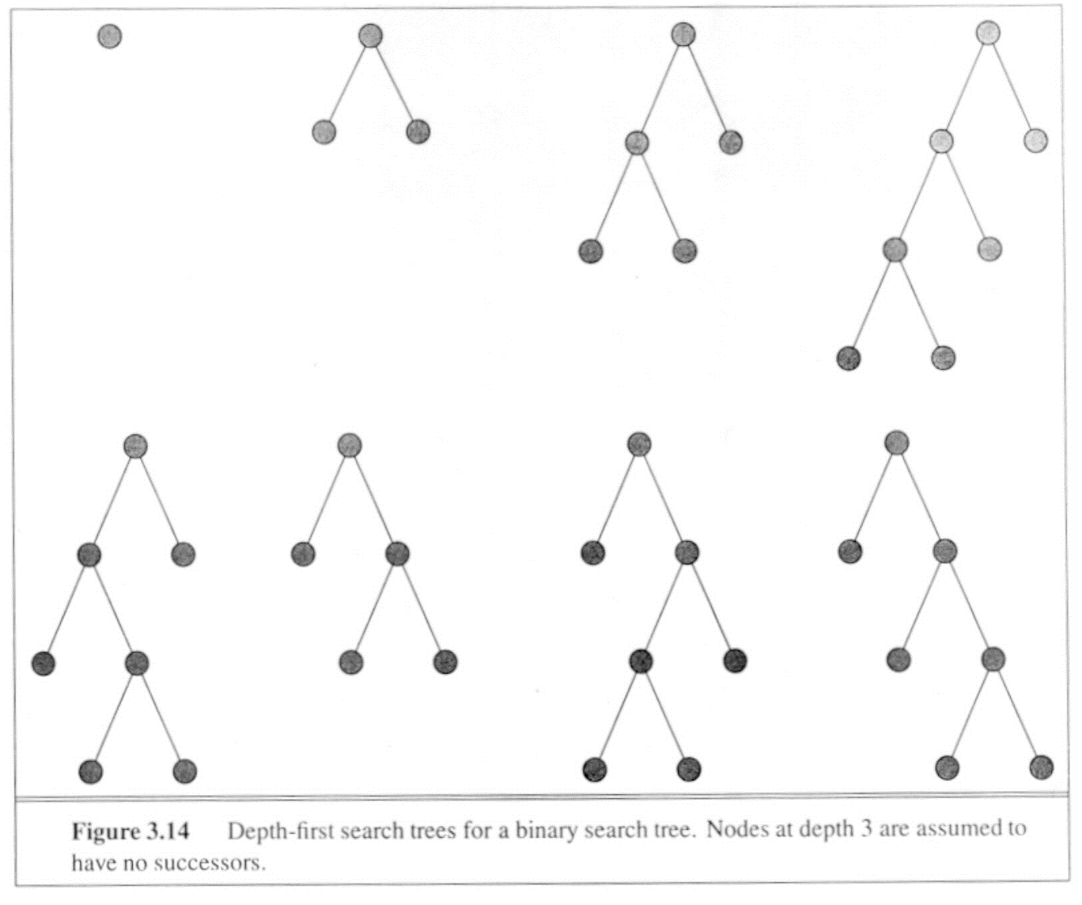
Depth-First Search
function DEPTH-FIRST-SEARCH (problem) returns a solution or failure
GENERAL-SEARCH (problem, ENQUEUE-AT-FRONT)
Nodes currently on the open list are circled in red.
Alternatively can use a recursive implementation.
Time Θ(b^{m}) (m is the max depth in the space)
Space Θ(bm) !
Not complete: m may be ∞
  E.g. grid search in one direction
Not optimal

Slide 18
Depth-Limited Search
Like depth-first search, except:
  Depth limit in the algorithm, or
  Operators that incorporate a depth limit
L = depth limit
Complete if L ≥ d (d is the depth of the shallowest goal)
Not optimal (even if one continues the search after the first solution has been found, because an optimal solution may not be within the depth limit L)
Θ(b^{L}) time
Θ(bL) space

Slide 19
Diameter of a Search Space
20 nodes, so a path can be no longer than 19 steps.
But in this graph, any city can be reached in at most 9 steps.
So the diameter of the search space is 9; this is an upper bound on L.

Slide 20
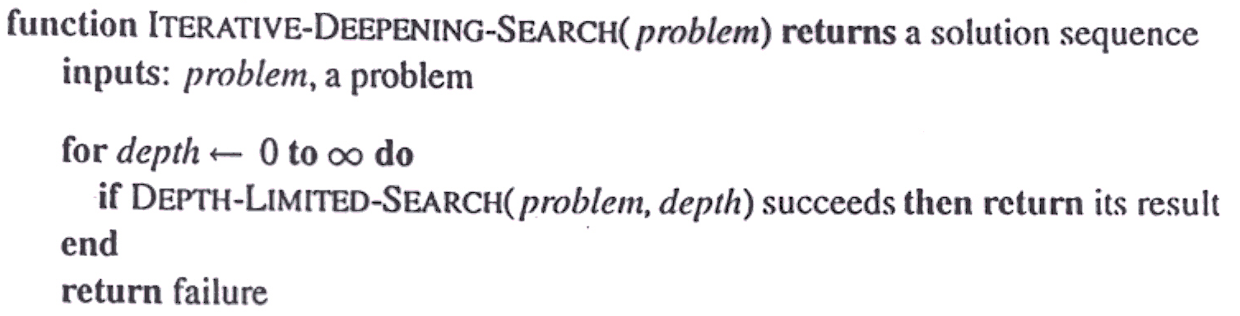
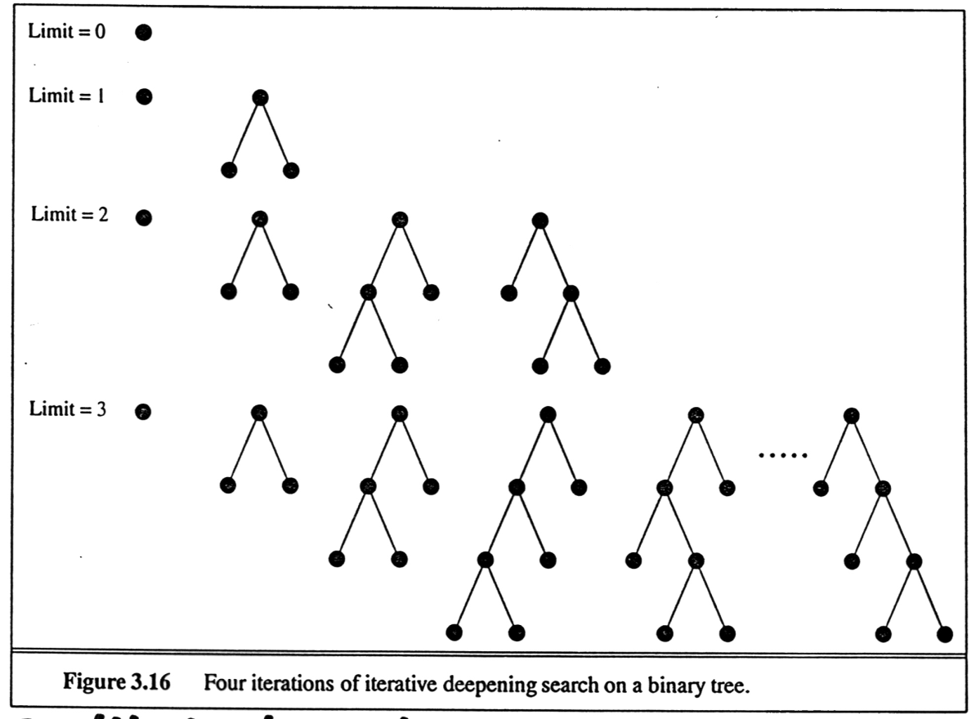
Iterative Deepening Search

Slide 21
Iterative Deepening Search
Complete, optimal, Θ(bd) space
What about run time?
Breadth first search:
1 + b + b² + … + b^{d-1} + b^{d}
E.g. b=10, d=5: 1+10+100+1,000+10,000+100,000 = 111,111
Iterative deepening search:
(d+1)*1 + (d)*b + (d-1)*b² + … + 2b^{d-1} + 1b^{d}
E.g. 6+50+400+3000+20,000+100,000 = 123,456
Run time is asymptotically optimal: Θ(b^{d}). We prove this next…

Slide 22
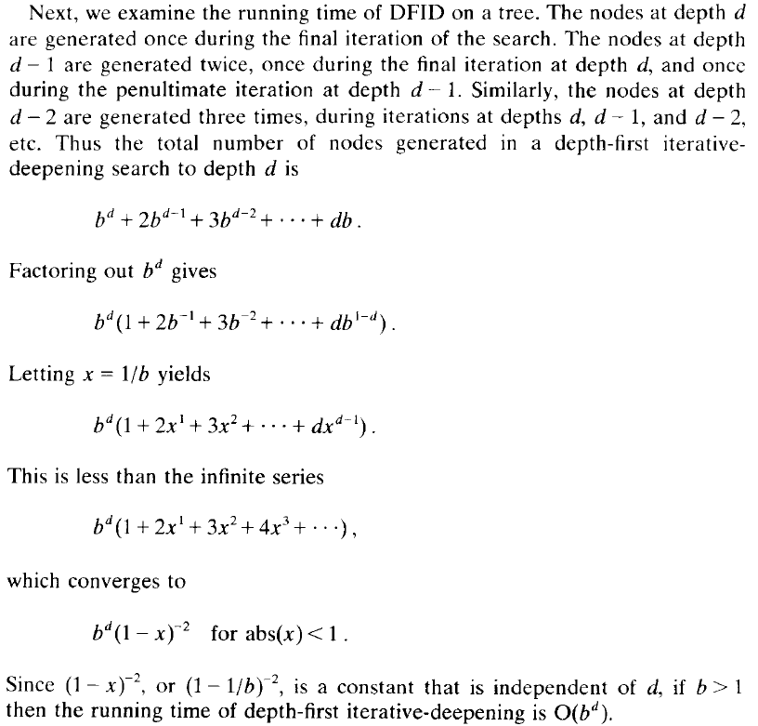

Slide 23
Question
Is iterative deepening preferred when branching factor is small or large?

Slide 24
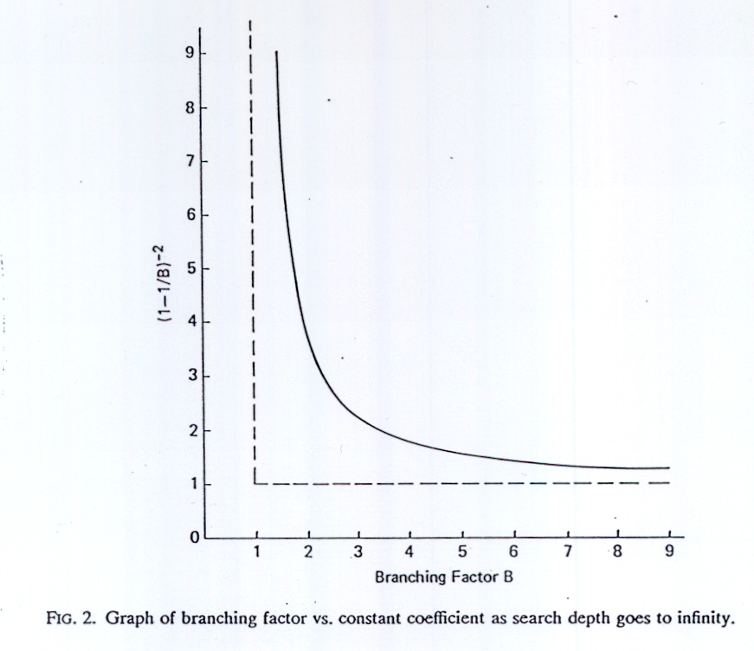
Iterative Deepening Search…
If branching factor is large,
most of the work is done at
the deepest level of search,
so iterative deepening does
not cost much relatively to
breadth-first search.
Conclusion:
Iterative deepening is preferred when search space is large and depth of (optimal) solution is unknown
Not preferred if branching factor is tiny (near 1)

Slide 25
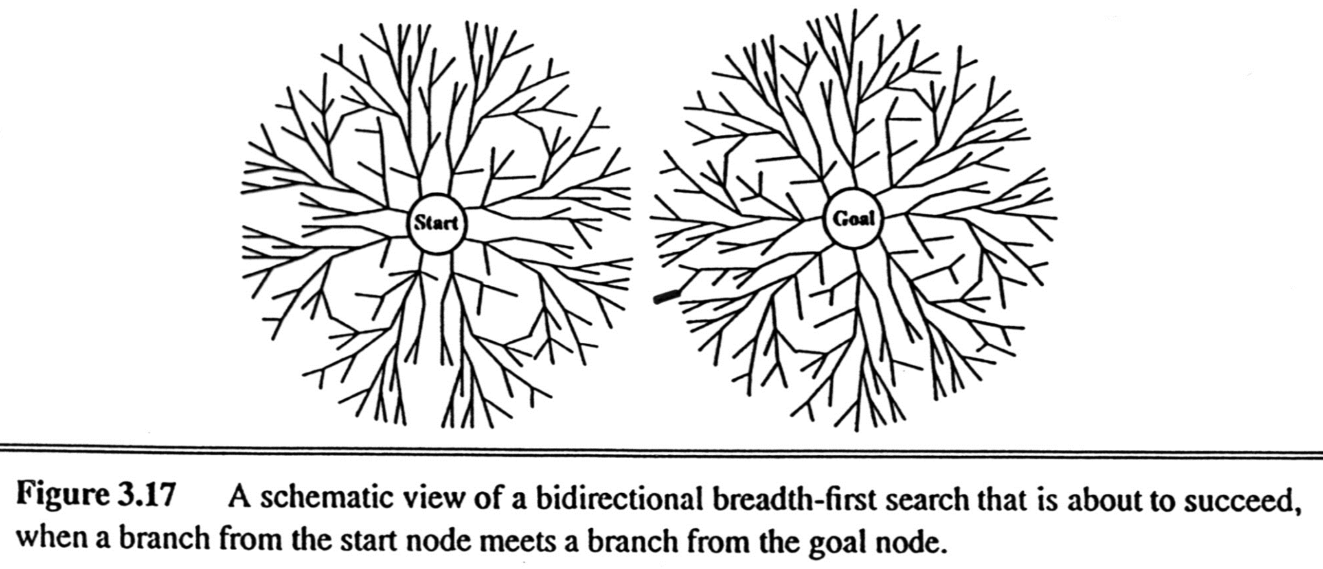
Bi-Directional Search
Time Θ(b^{d/2})

Slide 26
Bi-Directional Search …
Need to have operators that calculate predecessors.
What if there are multiple goals?
  If there is an explicit list of goal states, then we can apply a predecessor function to the state set just as we apply the successors function in multiple-state forward search.
  If there is only a description of the goal set, it MAY be possible to figure out the possible descriptions of “sets of states that would generate the goal set”…
Efficient way to check when searches meet: hash table
  1-2 step issue if only one side stored in the table
Decide what kind of search (e.g., breadth-first) to use in each half.
Optimal, complete, Θ(b^{d/2}) time
Θ(b^{d/2}) space (even with iterative deepening) because the nodes of at least one of the searches have to be stored to check matches

Slide 27
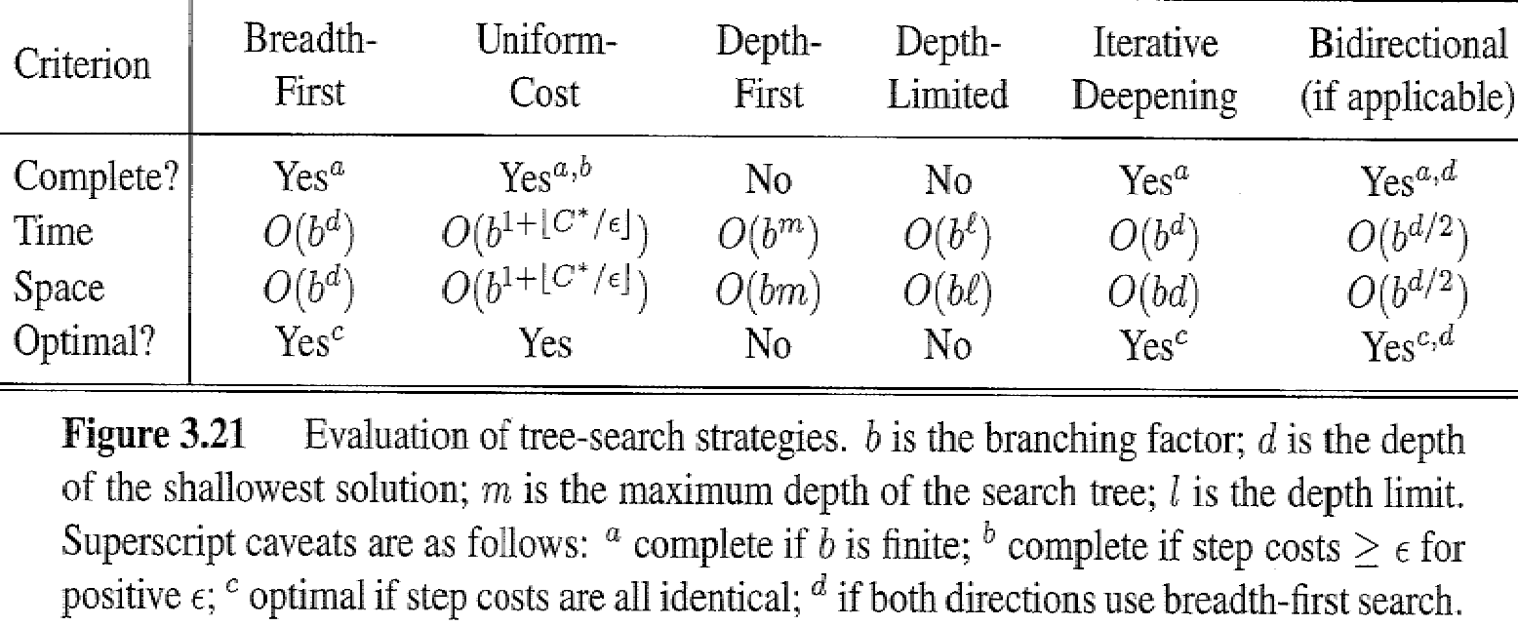
Summary

Slide 28
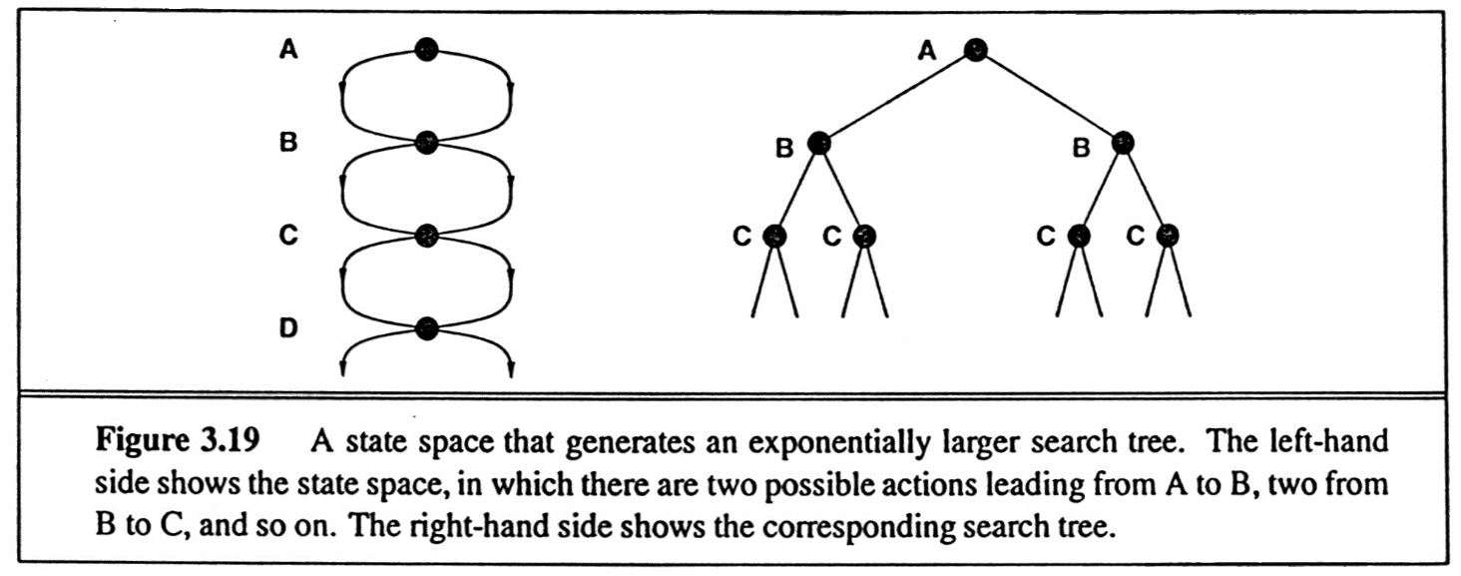
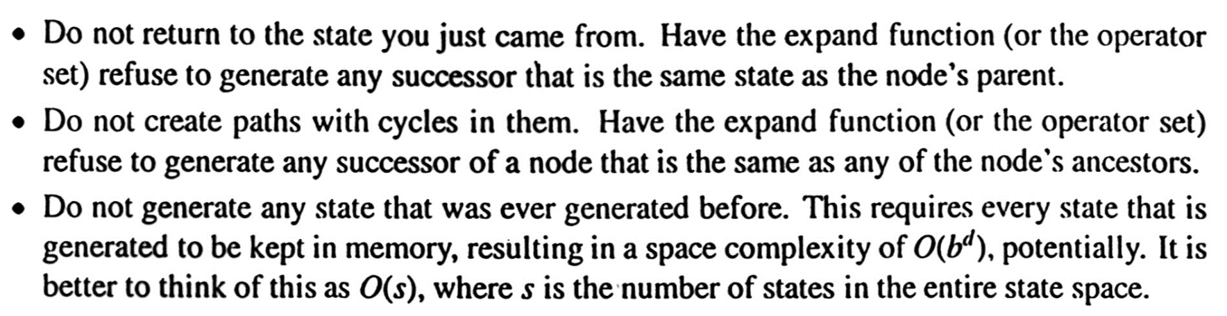
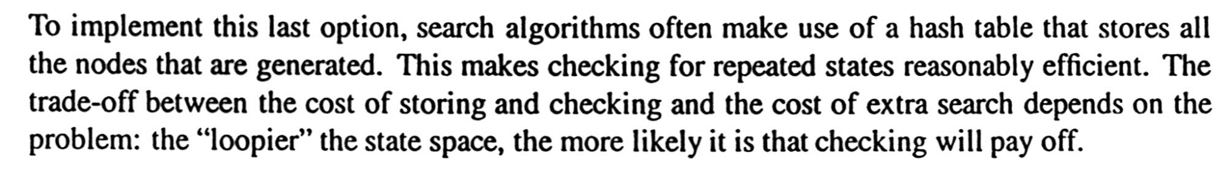
Avoiding repeated states
More effective & more computational overhead
With loops, the search tree may even become infinite

Slide 29
function TREE-SEARCH (problem) returns a solution, or failure
initialize the frontier using the initial state of problem
loop do
if the frontier is empty then return failure
choose a leaf node and remove it from the frontier
if the node contains a goal state then return the corresponding solution
expand the node, adding the resulting nodes to the frontier
function GRAPH-SEARCH (problem) returns a solution, or failure
initialize the frontier using the initial state of problem
initialize the explored set to be empty
loop do
if the frontier is empty then return failure
choose a leaf node and remove it from the frontier
if the node contains a goal state then return the corresponding solution
add the node to the explored set
expand the node, adding the resulting nodes to the frontier
only if they are not already in the frontier or the explored set

Slide 30
Finding a “Better” Path to a Node
Once a better path to a node is found, all descendants (not just children) of that node need to be updated for the new g value
  This can be done by having both parent and child pointers at each node
  This can still be a win in overall time because that tree that needs to be updated can still grow later, so we don’t want to replicate it
To avoid this, generate nodes by shortest possible path (UCS) if memory permits.

Slide 31
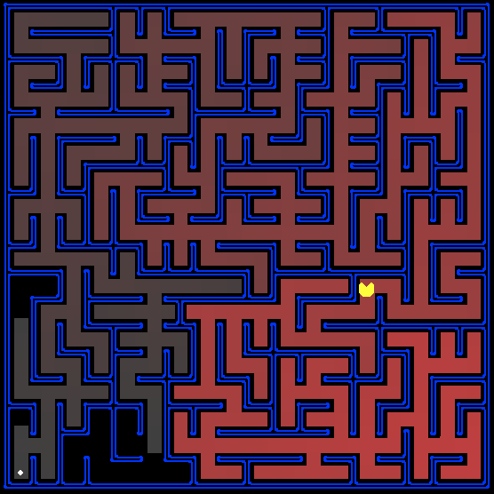
Homework 1

